Slide 1
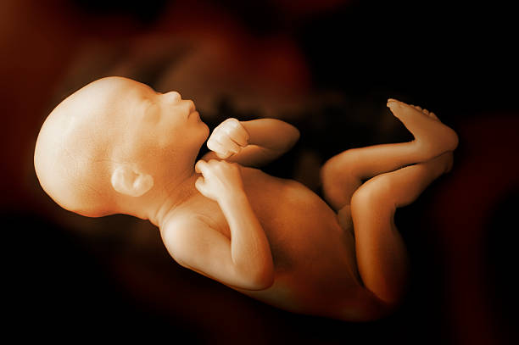
Predicting Fetal Health Using ML Classification Models
Project By: Daniel Premisler, Maria Gross, Oz Abukan
May 2021

Slide 2
Agenda
הצגת הדאטה או הבעיה
ניתוח מסוג meta analysis - מנתחים את מרחב הפתרונות ולא פתרון יחיד
עבודה על ה X הינדוס פיצ'רים - עבודה על real life data
עבודה על ה y ביזנס לוג'יק - ביפורקציה (לבדוק מה זה אומר)
בחירת מטריקה לעבודה - לציין שהתוצאות שלנו לא מאפשרות להביא ל recall ו presicion גבוה
התמודדות עם קלאסים לא מאוזנים
יצירת בייסליין מודל לבחינת טכניקות resampling שונות ואיך זה משפיע על הבייסליין לציין בבייסליין שy3-y6 דומים מאוד בתוצאות ולכן אפשר לצמצם את מרחב הפתרונות ל y3
בניית מרחב הפתרונות באמצעות automl ובחירת המודל המתאים ביותר לפי מטריקה נבחרת פר y
השוואת תוצאות ומסקנות - יציבות לעומת דיוק (mean and std)
מסקנות - חיבור לעולם האמיתי הנגשת פתרון שמסבירים שאין תוצאה מושלמת ועל כל רווח צריך לוותר על משהו אחר

Slide 3
Motivation
Reduction of child and maternal mortality is a key indicator of human progress.
In 2017 alone 295k deaths occurred during and following pregnancy and childbirth.
The vast majority of these deaths (94%) occurred in low-resource settings, and most could have been prevented.

Slide 4
Motivation
Cardiotocograms (CTGs) are a simple and cost accessible option to assess fetal health, allowing healthcare professionals to take action in order to prevent child and maternal mortality.
The equipment itself works by sending ultrasound pulses and reading its response, thus shedding light on fetal heart rate (FHR), fetal movements, uterine contractions and more.

Slide 5
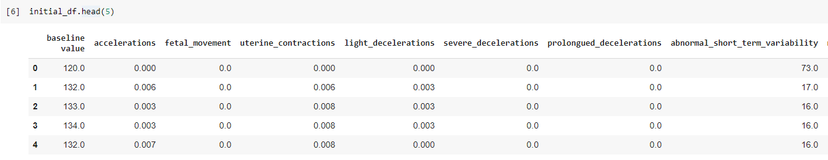
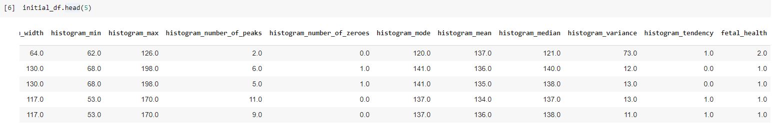
Data Description
Our Data - CTG(CardioTocoGraphy) tests results, CTG records various data with respect to the fetal heartbeat for example: contractions, accelerations, abnormal short term variability, 21 features, 2,126 tests.

Slide 6
Introduction - Our Goal
Our Goal - classify the fetus’s health into one of 3 conditions:
Normal
Suspect
Pathological

Slide 7
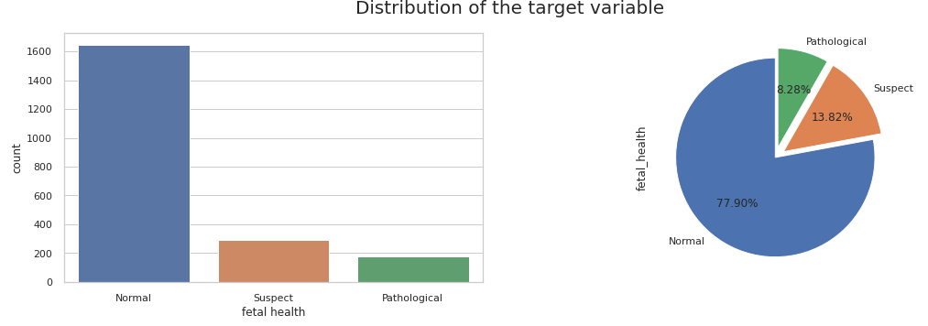
First look At The Data
We are dealing with a multi - class classification.
The data we are dealing with is imbalanced.
The most significant class for us to determine is the pathological one which is the rare label.

Slide 8
Data Preprocessing
No missing values were found.
13 duplicate record were dropped.
No categorical features, numerical only.
Few outliers were ignored.
All the features values were scaled in order to increase the performance.

Slide 9
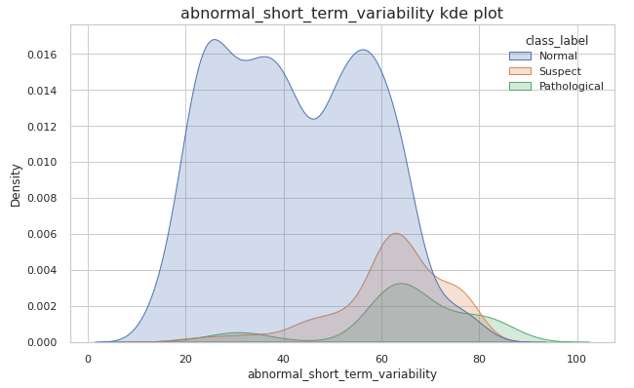
Exploring The Most Significant Features
Vast majority of normal observations are located in the lower range of the distribution.
Suspect and pathological observations are located in the higher range.
It’s more tricky to distinguish between the suspect and pathological classes since their distributions align.
1
2, 3

Slide 10
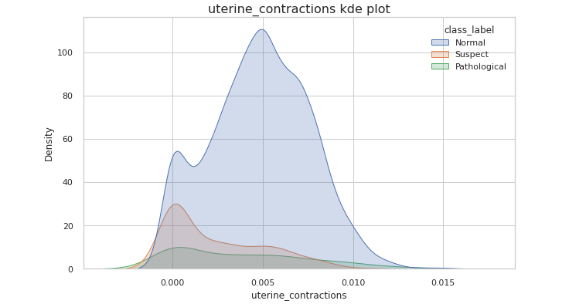
Exploring The Most Significant Features
Suspect and pathological class tend to not have any contractions, in fact if the test shows any contractions it's a pretty good sign that the fetus is likely healthy.
1

Slide 11
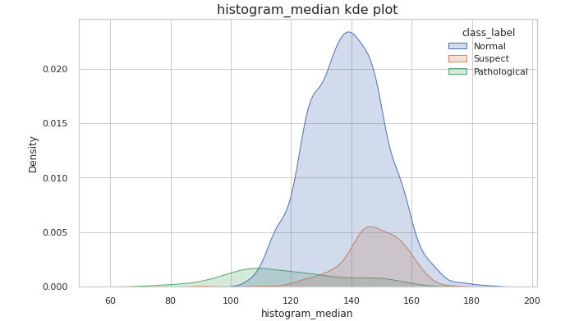
Exploring The Most Significant Features
Here we can distinguish between the pathological class versus the rest.
However, Normal and Suspect classes are harder to distinguish.
2
1

Slide 12
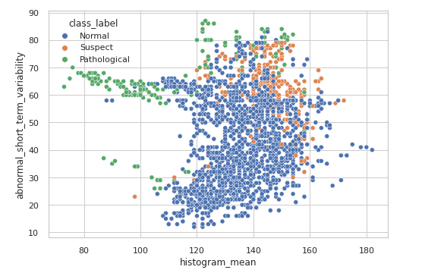
Exploring Feature Relationships
Pathological observations are located mostly in the range of low histogram mean and high abnormal heart beat.
Normal observations are located in the higher range of histogram mean and lower range of abnormal heart beat.
Suspect observations are located in the higher range of histogram mean and higher range of abnormal heart beat.
3
1
2

Slide 13
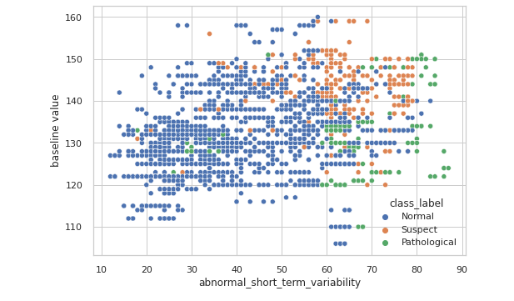
Exploring Feature Relationships
Pathological and suspect observations are located mostly in the high range of abnormal heart beat.
A cluster of suspect observations is seen in the upper - right corner if the plot.
Normal observations are located in the lower range of abnormal heart beat.
2
1
3

Slide 14
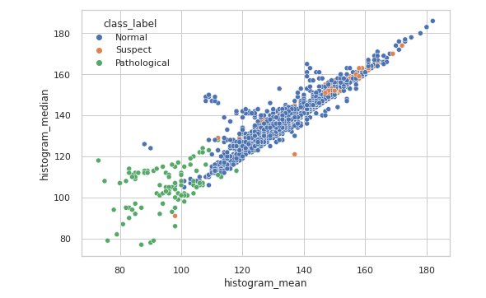
Exploring Feature Relationships
Pathological observations are located mostly in the range of low histogram mean/median.
Normal observations are located in the middle range of histogram mean/median.
Suspect observations are in the Normal class cluster.
We can see a clear clustering of the 2 classes (Normal and Pathological).
Suspect class is harder to distinguish.
3, 5
2
1
4

Slide 15
EDA Conclusions
It can be seen that it is relatively easy to classify both a normal fetus and a pathological one.
Classifying a ‘suspect’ fetus will be much harder, according to the EDA

Slide 16
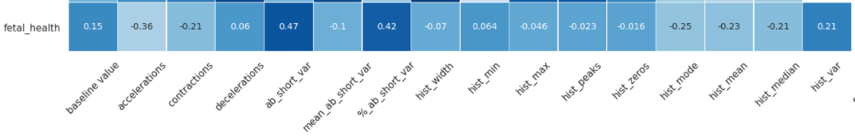
Pearson Correlation Matrix
The higher the correlation value the worse the fetal health is.
Features which deteriorate the fetal health
Features which increase the fetal health

Slide 17
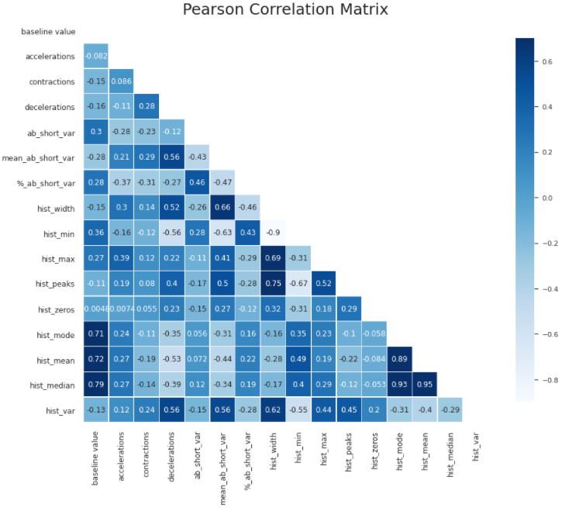
Pearson Correlation Matrix
Hist_mode, hist_mean and hist_median are highly correlated but we want to keep them all because they help clustering the classes
1

Slide 18
Classification Metric Selection
Selecting the best metric for the model is dependent on the errors we want to minimize which are:
False positive errors : Healthy fetus predicted as pathological
False negative errors : Pathological fetus predicted as normal
The model should address both errors, ergo: The metric of choice chosen is the F1 score, which is the harmonic mean of precision and recall
Selecting Macro instead of the weighted F1 was due to the fact weighted metric favours the major class and the purpose of the model is to focus on the minor classes instead

Slide 19
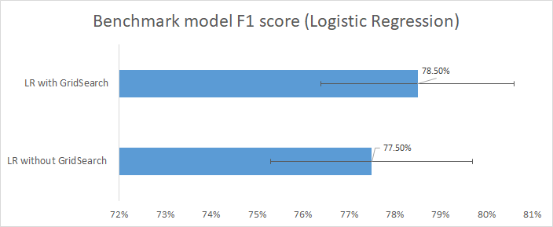
Classification Models
Logistics Regression best parameters: C: 5.45, Class_weight: balanced, Penalty: l1, Multi_class: auto

Slide 20
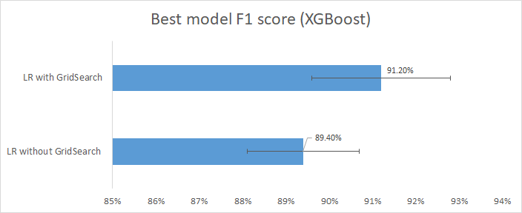
Classification Models
XGBoost classifier parameters: Colsample_bytree: 1.0, Gamma: 0.5, Learning_rate: 0.3, Max_depth: 7, Min_child_weight: 1, N_estimators: 100, Subsample: 0.8

Slide 21
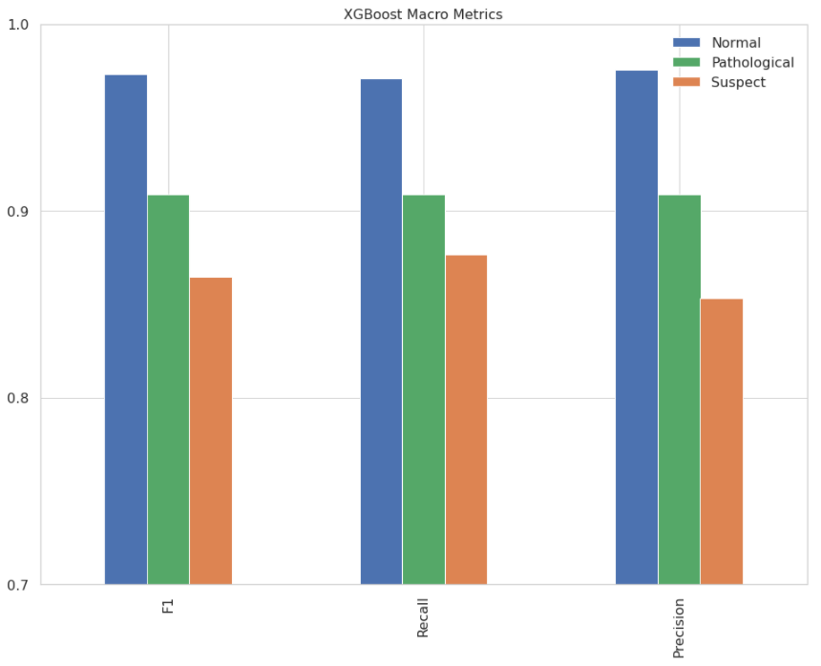
Best Model Metrics Per Class
class | Normal | Pathological | Suspect
F1 | 97.6% | 90.9% | 86.4%
1
Model Performs the best on the major class ‘Normal’ and struggles the most with ‘Suspect’ Class. As anticipated from the EDA

Slide 22
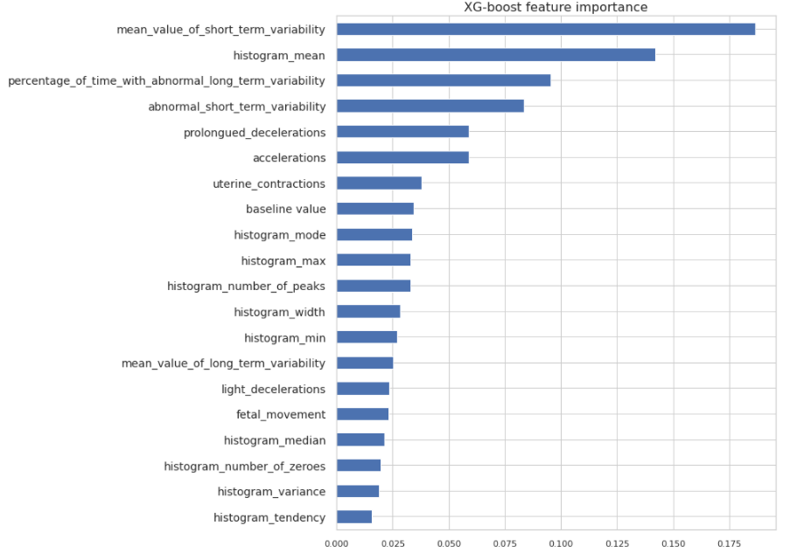
Feature Importance
1
Most Important features used by the model to differentiate between the class:
abnormal short term variability (with % and mean)
Histogram mean
Accelerations
Contractions
Prolonged decelerations
Pretty much what we saw from the EDA as well

Slide 23
Conclusions
Robustness
We used cross validation with 10 ‘StratifiedShuffleSplit’ folds of 80/20.
The F1 mean we got was 91.2% with a standard deviation of 1.6%.
Using ‘StratifiedShuffleSplit’ we feel our results are quite robust.

Slide 24
Conclusions
Methods we used which did not help boost performance
We tried to use SMOTE to help our model tackle the imbalance of our classes, however we did not saw an increase in our metrics.
We tried using Voting with various other models alongside our best model, but the performance deteriorated.

Slide 25
Conclusions
Items we didn't get to do
Make the model simpler using feature selection.
Employ more feature engineering maybe deal with some outliers.

Slide 26
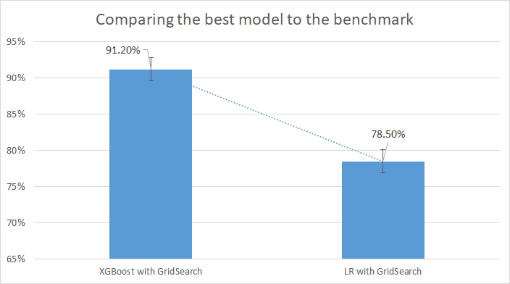
Conclusions

Slide 27
Key takeoffs
XGBoost worked best for this multi-class, imbalanced case ,F1=91.2% (1.6%)
Such model could be used to help identify fetal health, especially in 3rd world countries where professional personal is costly and scarce
Further research to find even better performing models is always recommended :)

Slide 28
Annex

Slide 29
Classification Models
Benchmark model:
Logistics Regression
Before GridSearch
Logistics Regression
parameters
Logistics Regression
After GridSearch
Test Results:
F1: 78%
Recall: 79%
Precision: 83%
Accuracy: 90%
Params:
C: 5.45
Class_weight: balanced
Penalty: l1
Multi_class: auto
Test Results:
F1: 79%
Recall: 82%
Precision: 77%
Accuracy: 88%
CV Results:
F1 mean: 77.5%
F1 STD: 2.2%
CV Results:
F1 mean: 78.5%
F1 STD: 2.1%

Slide 30
Classification Models
Best Model we get:
XGBoost classifier
Before GridSearch
XGBoost classifier
parameters
XGBoost classifier
After GridSearch
Test Results:
F1: 92%
Recall: 92%
Precision: 91%
Accuracy: 95%
Params:
Colsample_bytree: 1.0
Gamma: 0.5
Learning_rate: 0.3
Max_depth: 7
Min_child_weight: 1
N_estimators: 100
Subsample: 0.8
Test Results:
F1: 92%
Recall: 93%
Precision: 91%
Accuracy: 96%
CV Results:
F1 mean: 89.4%
F1 STD: 1.3%
CV Results:
F1 mean: 91.2%
F1 STD: 1.6%

Slide 31
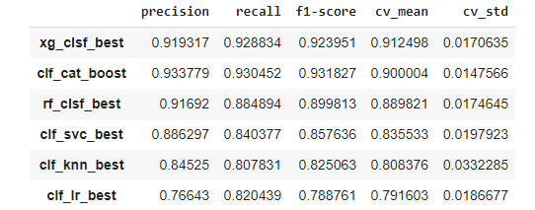
Classification Models

